Slide 1


Sustainability Issues and Opportunities
Visit bit.ly/canadiantire602 for more information!
Retail Team Members:
Pham, Viet Ha
Rahman, Safwan
Rodriguez, Sheila
Ruiz, Carlos
Class: ENBUS 602 at the School of Environment, Enterprise and Development, University of Waterloo
Professor: Dr. Amelia Clarke
Date Submitted: November 27, 2016

Slide 2

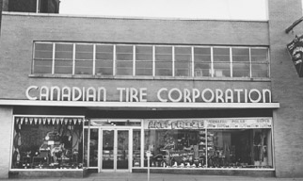


Agenda
1. Company Information
1. Company Information
2. Analysis of Key Interactions
3. Sustainability Issues
4. Solutions through Business Functions
5. Potential Challenges and Approaches
6. References
TIP:
Visit bit.ly/canadiantire602
for more information, and to listen to our narration of the presentation!
+28,000 employees
Headquartered in Toronto, Canada
+1,600 stores operating under various banners
The original Canadian Tire Store (CTC)
KEY DATES
1927 - Canadian Tire Corporation, Limited (“CTC”) founded by John & Alfred Billes
1980 – CTC’s revenue exceeded $1 billion
1999 – CTC Foundation launched
2001 – CTC launched its website
2006 – CTC partnered with NASCAR & TSN
2011 – CTC acquired Forzani Group
Operates 3 segments: Retail, REIT (real estate), and Financial Services
Revenue:
2015: $12.3 billion
2014: $12.5 billion
Publicly traded on TSX under CTC.A
This presentation focuses on the retail segment.
1
Notes:
Company info
Specify we will focus on retail
Instructions:
1. An introduction to the organization, including some information on i ts financial performance, location, business, etc.

Slide 3
2. Analysis of Current Social, Ecological, and Economic Interactions
CTC follows ethical business conduct with supplier codes and auditing systems.
Sustainable sourcing. e.g. teak furniture made from FSC-certified teak, which is engaged in forest stewardship programs.
Environmental Stewardship
Environmental Stewardship
Environmental Stewardship
Environmental Stewardship
Eco Equity – CTC has an innovation lab for sustainability. They also engage their employees in sustainability
Sufficiency – CTC needs to engage customers in sustainable consumption (ie. “Green” products
Society
Nature
CTC engages with with cotton farmers in sustainability and helps improve their livelihoods
Socio Effectiveness – Majority of CTC products do not cater to “bottom of pyramid”, which should be addressed.
Socio Efficiency – CTC has many community & charity programs, and also promotes healthy/active living.
Eco Effectiveness – CTC’s waste management in packaging and freight efficiency contribute to effective eco management.
Eco Efficiency – CTC aims to reduce ecological impacts through supply chain efficiency and energy consumption reduction, but more can be done.
CTC improves efficiency in manufacturing, transportation, and distribution process.
Social Interactions
Social Interactions
Economy/Profits
CTC participates in waste management and recycling programs.
CTC supports ethical sourcing, e.g. impelments workplace safety standards in Bangladesh
Business Case
2

Slide 4
3. Sustainability Issues
Sustainability Assessment | Initiatives and Integration | Why It’s Important
Waste | Waste management and waste diversion is part of CTC’s sustainability programs | Waste reduction is very important to CTC’s sustainability efforts. The company sells a variety of products, which results in a lot of waste for CTC (from excess inventory) and also for the consumers. By tackling waste, CTC positions itself as a forward-thinking company; the added benefit is the cost savings from simply reducing waste.
Ethical Sourcing | Follows “Supplier Code of Business” (human rights, child labour, health safety, env laws/standards) Product sourcing: Guarantees sustainability of forests and natural resources Product safety/compliance Factory worker safety | In an information-ridden age, the company’s ethical sourcing initiatives are crucial to demonstrating corporate citizenship and a trusted Canadian company. Worker health, safety, and integrity is important, not only in its own operations, but that of its vendors and suppliers. It is an overlapping effort with the company’s overall sustainability goals. Ethically sourced products helps create a brand CTC’s customers can relate to.
Energy Management | ISO 14001 Environmental energy management standards Energy efficiency improvement in outlets and company facilities GHG emissions in report, but no benchmarks/ or year-over-year change | The company’s energy management is tied to their environmental footprint as it reduces green house gases (GHG), consumes less resources, and is less wasteful. However, it is something that is also directly tied to CTC’s financial performance, as energy consumption at retail operations can be very costly.
61%
38%
Waste Diverted
Waste Landfilled
OUR FOCUS
3

Slide 5
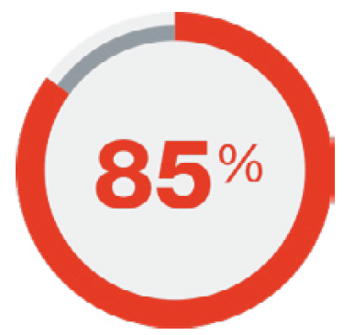


3. Sustainability Issues (cont.)
Sustainability Assessment | Initiatives and Integration | Why It’s Important
Commitment to Communities | Canadian Tire Jumpstart: Providing children in financial need with access to sports and recreation Community charity for kids: >$9M in 2008 Helped 151,000 kids since 2005 Lucky Clover: Canada’s largest housing co-op for median income and families below poverty line Consulting with local community stakeholders | The company is known as a trusted and admired Canadian brand. CTC’s community commitment is pivotal to the way the brand continues to be seen around the country. It is the social side of their sustainability efforts, and the company sees it as an opportunity to leave a legacy.
Transportation and Logistics | Efficiency in transportation is sustainability focus. Current efforts will improve freight capacity by 13%, so more products transported per trip In some parts of Canada, they’re switching from road distribution to rail, reducing emissions by 60%, however little innovation in clean energy for transport Improvements are being made in product packaging and preventing shipping damage of goods | CTC has the largest ground transportation network in the whole country. Efficiency in this activity is key to their sustainability performance. It is also something tied to direct cost per unit, and has an impact on the company’s financial performance.
Product and Packaging
Transportation
Retail Operations
GHG Emissions by Segment of Business
Source: Canadian Tire Sustainability Report, 2015-2016
4

Slide 6
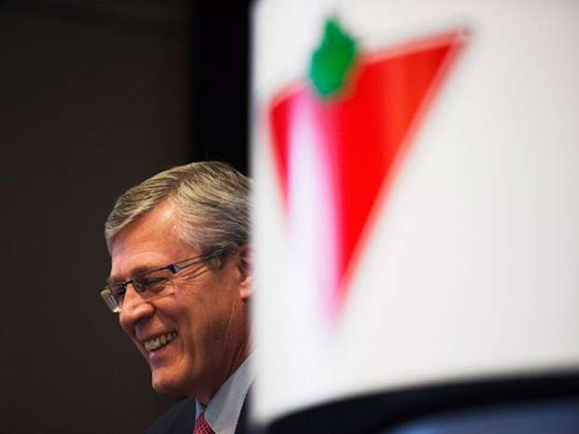
4. Solutions through Business Functions
With goods and services sourced globally from approximately 90 countries around the world, ethical buying and selling are integral to the company’s social, ethical and environmental performance. A bold strategy is necessary to continue and improve on the company’s current initiatives.
Senior Management, Strategy & Governance
Senior Management / Strategy: For senior management, the focus is on value creation for CTC’s customers, employees, communities, suppliers and shareholders. This process is circular in its progression and can be exemplified when tackling sustainability challenges such as with ethical buying and selling initiatives. As such, we propose the following:
Create greater strategic vision and long term sustainability planning for and by senior management
Integrate sustainability initiatives / goals into cross functional business units
- While managing costs, increasing operational efficiencies and
increasing revenue from business sustainability initiatives
- Find markets that will assist in working towards these goals
Stephen Wetmore, Canadian Tire CEO (CTC)
Innovate with new strategic frameworks, such as the Blue Ocean strategy
  - By means of creating a new market space with low pricing and high differentiation through ethical
  sourcing and selling
Seek out partnerships with retailers who have implemented stringent ethical sourcing strategies to share knowledge
Seek out opportunities to market the company as having the most developed ethical sourcing policies in Canada
Walk the talk, leading by example management will be necessary to show the rest of the staff to apply similar principles in their own lives (i.e. wearing only ethically sourced clothing).
5

Slide 7

4. Solutions through Business Functions
Senior Management, Strategy & Governance (cont.)
Governance:
Select a board of directors from a balanced set of stakeholders who best support the execution of CTC’s sustainability strategies
Oversee continued development of policy frameworks governing Codes of Conduct such as with the Supplier Code of Business Conduct
Develop internal governance mechanisms to drive sustainability initiatives. These controls are instrumental in monitoring and measuring progress of these initiatives and taking corrective actions when required
Communicate the company’s vision with all employee levels, and set standards and rewards for those employees advancing sustainability initiatives.
Maureen Sabia, Chairman of the Board at Canadian Tire Corporation, as seen from a screen capture of CTC’s website (CTC)
6

Slide 8
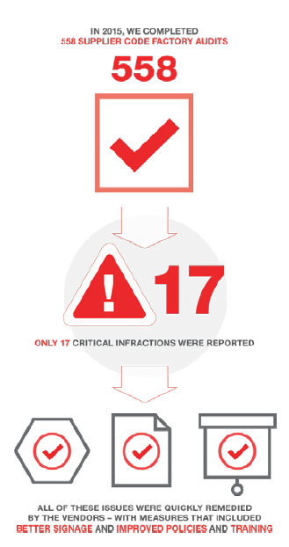
4. Solutions through Business Functions (cont.)
Procurement / Purchasing & Supply Chain Management
CTC works with suppliers throughout their entire global supply chain to ensure compliance with their Codes of Conduct. Products are responsibly sourced, manufactured, and transported according to the standards outlined in the company’s Supplier Code of Business Conduct (SCBC) and their Business Social Compliance Initiative (BSCI). However, their procurement process and supply chain system can yet be further developed.
Procurement / Purchasing:
Create supplier sustainability scorecards to systematically measure the sustainability of their various suppliers. The scorecards can measure energy and water use, recyclable materials, waste, and greenhouse gas emissions, employee health and safety of the entire supply chain
Through CTC’s procurement, continue to eliminate the use of harmful chemicals and pesticides throughout their entire manufacturing process
Diversify product portfolio by becoming more aware of local community vendors and Canadian Small Medium Enterprises (SMEs) while still maximizing opportunities for global sourcing
Highlight CTC’s Ethical Sourcing initiative on the online procurement platform and supplier registration page to attract more sustainably focused suppliers
      - Currently, the online supplier registration page simply provides
      instruction on the procurement process using a registration database
      (Vendor Gateway) to source RFQs and Vendor contractual information
Implement a reward program for vendors who achieve 0 audit infractions on a consistent basis.
An example of CTC’s sustainable supply chain program as outlined in the company’s 2015-2016 Sustainability Report (CTC)
7

Slide 9
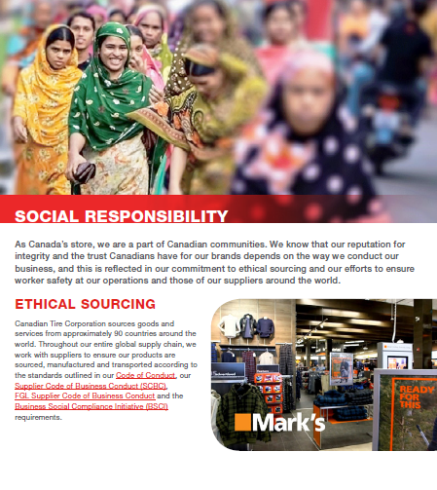
4. Solutions through Business Functions (cont.)
Procurement / Purchasing & Supply Chain Management (cont.)
Supply Chain Management:
Train suppliers and their employees on the implementation and compliance of CTC’s Codes of Conduct (SCBC and BSCI); this would also include the distribution of the codes to factory employees as well as its translation into the country language
Innovate and work with suppliers to help them find efficiencies and improve their environmental performance, through continued supplier engagement, training opportunities, and management site visits, and 3rd party audits
Monitor supply chain to bribe-proof it from foreign personnel looking to deviate from the company’s ethical sourcing values.
CTC devoted a section to ethical sourcing in its 2015-2016 Sustainability Report (CTC)
8

Slide 10
4. Solutions through Business Functions (cont.)
Operations, Manufacturing Innovation and IT
CTC’s focus on productivity ensures its business growth through more efficient operations, while minimizing its environmental footprint. Operational controls are also in place to measure the company’s performance on key strategies, as well as provide the basis for a corrective plan of action. The company’s continued innovation towards improved production methodology, effective information systems, and flexible manufacturing are leading to successful results in cost leadership/ differentiation strategies – all of which ethical sourcing is directly or indirectly related.
Operations:
Continue to integrate sustainability goals and practices into business operations whereby ethical sourcing results in a value-add for internal and external stakeholders
Ethically source and buy materials for retail operations through store retrofits, lighting retrofits, and roofing retrofits including rooftop solar systems installed on 32 of their stores
Manufacturing Innovation:
Continue with product and process innovation exemplified in the company’s Structural Packaging Test (SPT) to improve the current supply chain handling process.
    - Products and their packaging are put through a series of rigorous tests to minimize damage during
    shipping, handling and storage.
Continue to focus on product development teams to find ways to manufacture and ship these products more efficiently
- Currently, CTC has been able to increase the density of products per pallet and package by 40-50%,
reducing the number of containers coming from China.
Consider sourcing from more sustainable factories in the future.
9

Slide 11
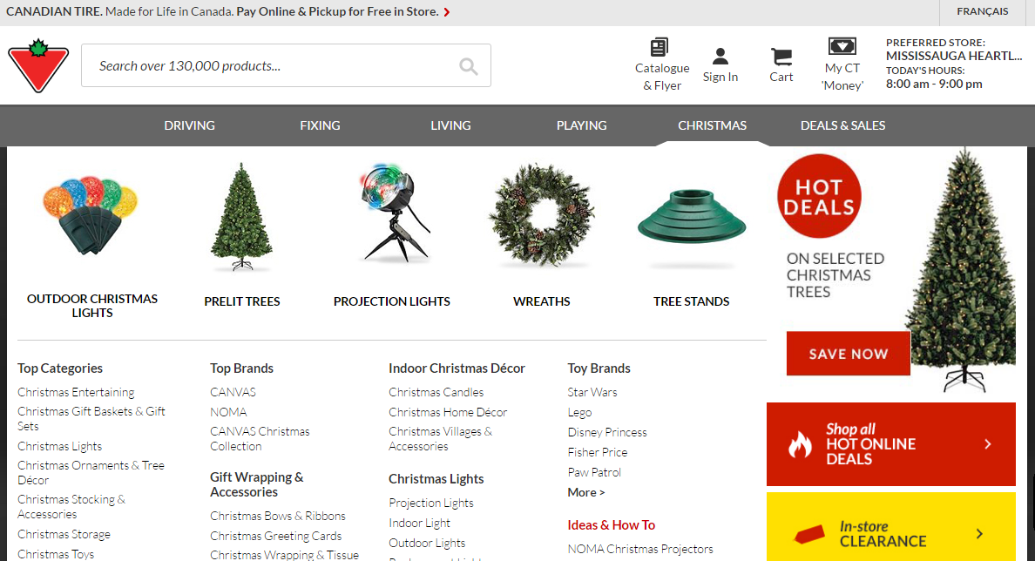
4. Solutions through Business Functions (cont.)
Operations, Manufacturing Innovation and IT (cont.)
Information Technology:
Implement continuous technology-enabled reporting to connect raw materials, components, manufacturing and retailers all to cloud
Consider new agile methodologies because the next generation of retail technology leaders will require a culture of innovation:
  - Launching new digital technology, mobile, and e-commerce functionality
  - Creating new platforms for service delivery across brands.
CTC’s online shopping website (CTC)
10

Slide 12
4. Solutions through Business Functions (cont.)
Environmental Affairs & Sustainability Management
To drive continuous environmental improvement, CTC operations and facilities conform to ISO 14001 Environmental Management Standards. The company recognizes the importance of integrating environmental concerns into business operations and corporate strategy. In managing potential external threats (as well as opportunities), ongoing environmental scanning and analysis is required.
Monitor LOHAS (lifestyles of health and sustainability) consumer trends
Provide continued commitment to environmental stewardship (currently over 60 projects) and a sustainable forestry initiative
  - This includes ethical paper procurement and usage to support their sustainable forestry initiative
Expand partnerships with international organizations such as the UN Global Compact, and global fair-trade suppliers
Continue research and participation in new sustainability management strategies such as the Circular Economy model
  - Involvement with Natural Step and the Ontario Circular Economy Innovation Lab (CEIL); and their
  participation in this new program bringing together private & public sector leaders, and innovators to
  design, test and implement circular economy solutions
  - Support and involvement with the social enterprise Toronto Tool Library whereby CT has donated
  many tools; the case study and Circular Economy (CE) solution promotes the continued life cycle of
  these products in the sharing economy
Implement a product take back program where the community can participate bringing in these products to properly recycle them (e.g. CFL light bulbs, batteries, paint, used oil, etc).
Research ways to support local environmental issues important to the company (e.g. shore clean up, community recycling days, etc.).
11

Slide 13
4. Solutions through Business Functions (cont.)
Marketing and Stakeholder Relations
With the changing retail landscape, a sustained competitive advantage can be difficult to achieve. Once achieved, it offers resilience without losing its value even in times of change brought on by external factors. CTC has accomplished just that – a sustained competitive advantage. The company’s commitment to sustainable practices including ethical sourcing throughout their supply chain and internal operations, have helped improve shareholder value and continued market growth. The improved shareholder value has been gained through social and environmental value creation.
Highlight CTC’s involvement in over 60 environmental stewardship programs for products such as used tires, electronics, used oil, light bulbs, household batteries, leftover paint, beverage containers, and product packaging.
Implement a communication strategy to investors regarding CTC advancing sustainability practices
    - Draw relation between refining of ethical sourcing practices with the increase of the company’s value to
    stakeholders
    - Connect ethical sourcing with the company’s greater sustainable development
Implement a grading system to markets ethically sourced products (i.e. tag a gold label on those products that meet the highest ethically sourced standards such as fair trade)
Implement a robust ethical sourcing strategy; this shows customers’ concern for greater issues of the business and perhaps environmental impacts on communities.
Canadian Tire delivery trucks serve as great advertising billboards (CTC)
12

Slide 14
4. Solutions through Business Functions (cont.)
Human Resource Management
Implement a commitment to responsible sourcing of talent; recruitment for procurement roles would require buyers with experience and interest in ethical sourcing initiatives
Create sustainable HR systems and processes that institutionalize sustainability at all levels of the organization
    - Implement an ethical sourcing leader in the organization
Communicate the ESG vision of the company from top down
  - Monitor employee engagement to ensure alignment of behaviours with the company’s set of ethical
  standards and values.
Accounting and Finance
CTC Reporting follows the GHG Protocol Corporate, Project and Value-Chain (Scope 3) Accounting Standards. The GHG Protocol Initiative is a multi-stakeholder collaboration facilitated by the World Business Council on Sustainable Development (WBCSD) and the World Resources Institute (WRI) to establish and promote business standards for GHG accounting and reporting.
Using the abovementioned tools, track costs of improving ethical sourcing initiatives
Integrate sustainable efforts from the company with the financial documents
Implement a sustainability fund from the company’s yearly revenues to pay for projects that advance the company’s sustainability objectives
Align the company’s sustainability reporting with GRI – global reporting initiative to help understand and communicate CTC impacts on issues such as climate change, human rights and corruption.
13

Slide 15




5. Potential Challenges
OUR FOCUS
CHALLENGE 1: IMPLEMENT A PRODUCT TAKE-BACK PROGRAM
This program proposes that the retail locations serve as “drop-off” points for the general public to bring back certain products, such as CFL light bulbs, batteries, paint, used oil, etc. This can create logistical challenges with the stores, the waste collectors, the manufacturers, and the general public. There may be little awareness of the program, resulting in too little waste collected, or too much awareness of the program, resulting in an oversupply of product drop-offs.
CHALLENGE 2: CREATE GREATER STRATEGIC VISION AND LONG-TERM SUSTAINABILITY PLANNING
Sustainability investments that have long payback periods may not be approved because CTC is still a public corporation that answers to shareholders, who look for quarterly dividend payments. The challenge is to simultaneously appease short-term economic goals and long-term sustainability objectives.
CHALLENGE 3: TRAIN SUPPLIERS AND WORK WITH THEM TO IMPROVE THEIR ENERGY EFFICIENCIES AND ENVIRONMENTAL PERFORMANCE
CTC must be in a credible position to provide advice to suppliers, some of whom may actually be more advanced than CTC in terms of sustainability. CTC must forge close relationships with suppliers so that they fully support CTC’s training initiatives and supply chain requirements.
14

Slide 16

5. Approaches to Overcome Challenge 1
Get Buy-In from Waste Collectors: Position this as additional revenue opportunity for them and a chance for them to be good corporate citizens.
Get Buy-In from Suppliers, Senior Management, and Employees: This is important so that additional resources and promotion can be provided to the program.
Plan Carefully: This requires a lot of logistical planning, involving multiple stakeholders. Products are being returned at different locations, being sorted at different facilities, by different companies. Therefore, it is important to plan and potentially run a test/pilot before rolling it out to all retail locations.
Designate Clear Accountabilities: Given the numerous stakeholders involved, be clear on who is responsible for what. Make sure people know who to reach out to if they have questions.
Communicate Internally and Externally: The program will fail if consumers do not know about it and do not bring products in. Therefore, communicate externally (using marketing tools) but also internally so employees tell their friends and family about the program.
Have a Contingency Plan: Acknowledge when things do not go well, prepare to stop the program if necessary, and prepare for the unexpected.
Share Results and Celebrate Wins: Monitor, measure, and share the results and share success with stakeholders to maintain momentum of the program.
15

Slide 17
6. References
Canadian Tire Corporation. (n.d.a). About Us. Retrieved from http://corp.canadiantire.ca/EN/AboutUs/Pages/default.aspx
Canadian Tire Corporation. (n.d.b). Commitment to Communities. Retrieved from
http://corp.canadiantire.ca/EN/CorporateCitizenship/Commitment/Pages/default.aspx
Canadian Tire Corporation. (n.d.c). Corporate Citizenship. Retrieved from
http://corp.canadiantire.ca/EN/CorporateCitizenship/Pages/default.aspx
Canadian Tire Corporation. (n.d.d). Environmental Sustainability. Retrieved from
http://corp.canadiantire.ca/EN/CorporateCitizenship/EnvironmentalSustainability/Pages/default.aspx
Canadian Tire Corporation. (n.d.e). Responsible Sourcing. Retrieved from
http://corp.canadiantire.ca/EN/CorporateCitizenship/ResponsibleSourcing/Pages/default.aspx
Canadian Tire Corporation. (n.d.f). Retail Stores. Retrieved from
http://corp.canadiantire.ca/EN/JOINOURTEAM/EXPERIENCEDPROFESSIONALS/Pages/RetailStores.aspx
Canadian Tire Corporation. (2013). Canadian Tire Retail Supply Chain Toronto Operations Environmental Policy. Retrieved from
http://corp.canadiantire.ca/EN/CorporateCitizenship/EnvironmentalSustainability/Documents/Sustainability_ENG_
December%2019, %202013_FINAL.pdf
Canadian Tire Corporation. (2015). Report to Shareholders. Retrieved from
http://s2.q4cdn.com/913390117/files/doc_financials/annual/2015/Canadian-Tire-Corporation_2015-Annual-Report_ENG.pdf
Canadian Tire Corporation. (2016). Canadian Tire Corporation Sustainability Report 2015 – 2016. Retrieved from
http://sustainability.canadiantirecorporation.ca/_doc/CTC_SR_PDF_2016_09_02.pdf
16
Notes:
Include at least 5 readings from the course

Slide 18
6. References (cont.)
Clarke, A. (2016a). History of Corporate Sustainability. [Presentation slides]. Retrieved from
https://learn.uwaterloo.ca/content/enforced/266638-ENBUS602_081_cel_1169/Modules/Module%2002/2b1_
HistoryOfCorporateSustainability.pdf?_&d2lSessionVal=HIrDjbFQWDVU7rm0uyitr8pZB&ou=266638
Clarke, A. (2016b). Introduction to Sustainable Development. [Presentation slides]. Retrieved from
https://learn.uwaterloo.ca/content/enforced/266638-ENBUS602_081_cel_1169/Modules/Module%2001/1c1_IntroductionTo
SustainableDevelopment.pdf?_&d2lSessionVal=HIrDjbFQWDVU7rm0uyitr8pZB&ou=266638
Clarke, A. (2016c). Leadership and Roles. [Presentation slides]. Retrieved from https://learn.uwaterloo.ca/content/enforced/266638-
ENBUS602_081_cel_1169/Modules/Module%2005/5a2_LeadershipAndRoles.pdf?_&d2lSession
Val=qsXp1t5NazG5Vk11a0dushlAI&ou=266638
Hart, S., Christensen, C. (2002). Great Leap - Driving Innovation from the Base of the Pyramid. MIT Sloan Management Review,
44(1), 51-56. Retrieved from
https://learn.uwaterloo.ca/content/enforced/266638-ENBUS602_081_cel_1169/eReserves/GreatLeap.pdf?ou=266638
Historica Canada. (2014). Canadian Tire Corporation Limited. Retrieved from
http://www.thecanadianencyclopedia.ca/en/article/canadian-tire-corporation-limited/
Kolk, A., Rivera-Santos, M., and Rufín, C. (2013). Reviewing a Decade of Research on the "Base/Bottom of the Pyramid" (BOP)
Concept. Business and Society. Retrieved from https://learn.uwaterloo.ca/content/enforced/266638-
ENBUS602_081_cel_1169/eReserves/ReviewingDecadeBOPConcept.pdf?ou=266638
Laasch, O. & Conaway, R. (2015). Principles of Responsible Management: Glocal Sustainability, Responsibility, and Ethics (1st ed).
Stamford, CT: Cengage Learning.
Visser, W. & CPSL (2009) Landmarks for Sustainability: Events and Initiatives That Have Changed the World. Sheffield: Greenleaf.
17
Notes:
Include at least 5 readings from the course

